Slide 1
Slide 1 – News Complexity & Readability
News categorized into low vs. high difficulty using Flesch-Kincaid Readability Score.
High-difficulty news requires greater language comprehension.
Advanced LLMs like GPT-4 outperform simpler models on complex text.

Slide 2
Slide 2 – Articles vs. Press Releases
News articles: neutral, journalist-written, less strategic framing.
Press releases: firm-issued, strategically worded to influence perception.
Simple models (BERT, GPT-2) struggle with PR messaging; GPT-4 parses nuance well.

Slide 3
Slide 3 – Predictability Window
GPT-4 scores capture immediate market reaction to news.
Predict returns strongly for the next two trading days.
Predictability fades afterward → information absorbed by market.

Slide 4
Slide 4 – Strategy Performance Over Time
Evidence of declining predictability as GPT adoption increases.
Annualized Sharpe ratio trend:
• 2021 Q4: 6.54
• 2022: 3.68
• 2023: 2.33
Indicates improving market efficiency.

Slide 5
Slide 5 – Model: Information Precision
News signal: s = μd + ε, ε ~ N(0, 1/τS).
Information precisions:
• Attentive: τA = γA τS
• Inattentive: τI = ω τA
• LLM: τL = λ(c, k) τS
LLMs' precision increases with model size k and decreases with complexity c.

Slide 6
Slide 6 – Predictive Regression
Return regression specification:
ri,t+1 = ai + bt + γ' xi,t + εi,t+1
xi,t includes ChatGPT sentiment score (YES=1, NO=-1, UNKNOWN=0).
Firm and day fixed effects control for unobserved heterogeneity.

Slide 7
Slide 7 – Data Sources & Prompt
Datasets used:
• CRSP daily stock returns
• News headlines dataset
• RavenPack analytics
• NYSE TAQ intraday trades and quotes
Prompt used for headline scoring:
'YES', 'NO', or 'UNKNOWN' + one-sentence reasoning.

Slide 8
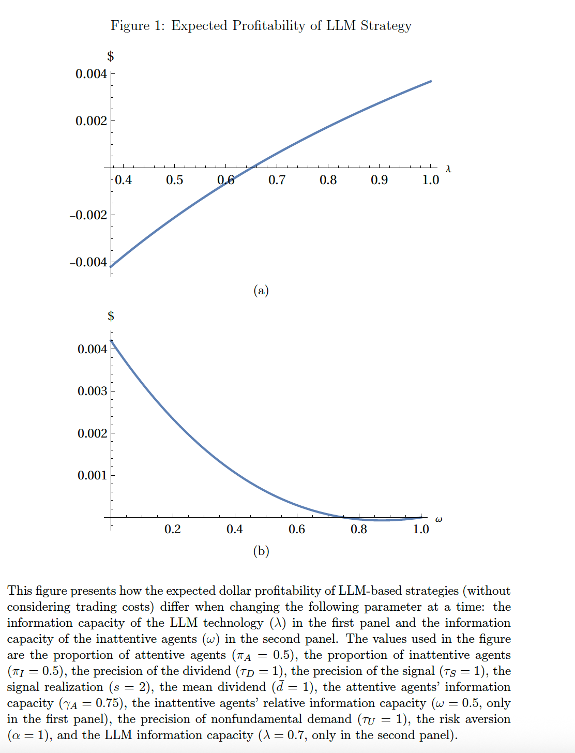

Slide 9
